Slide 1
BillBuddy
OOD Project
Induja Ragava
SUID: 304258050

Slide 2
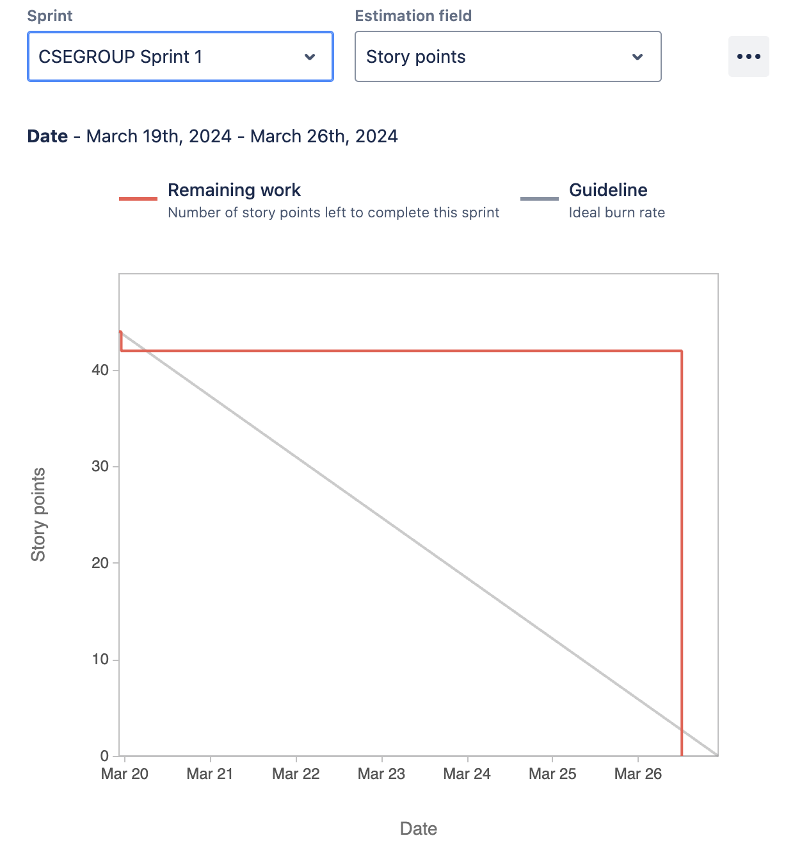
Sprint 1

Slide 3
Issue Ticket: G01687SP24-4, G01687SP24-12, G01687SP24-16
Create responsive UI for login and signup
Developing the Home page interface with more features

Slide 4
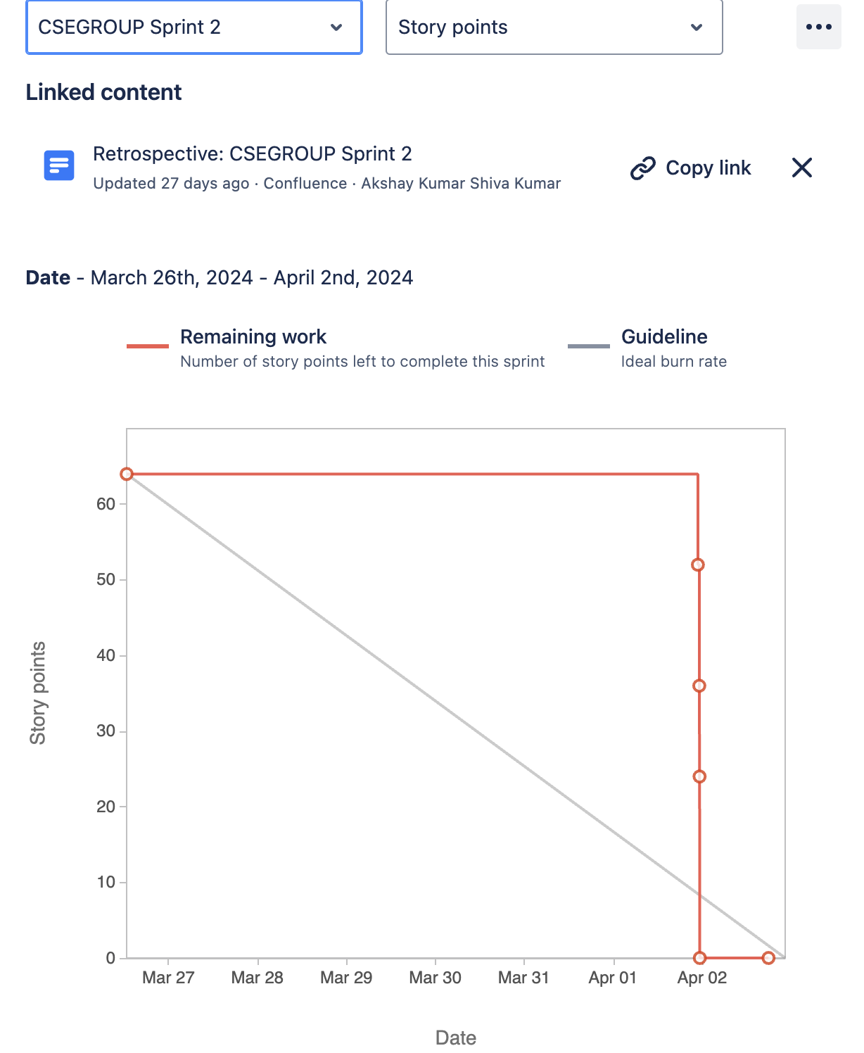
Sprint 2

Slide 5
Ticket Issue: G01687SP24-16
Developing the Home page interface with more features

Slide 6
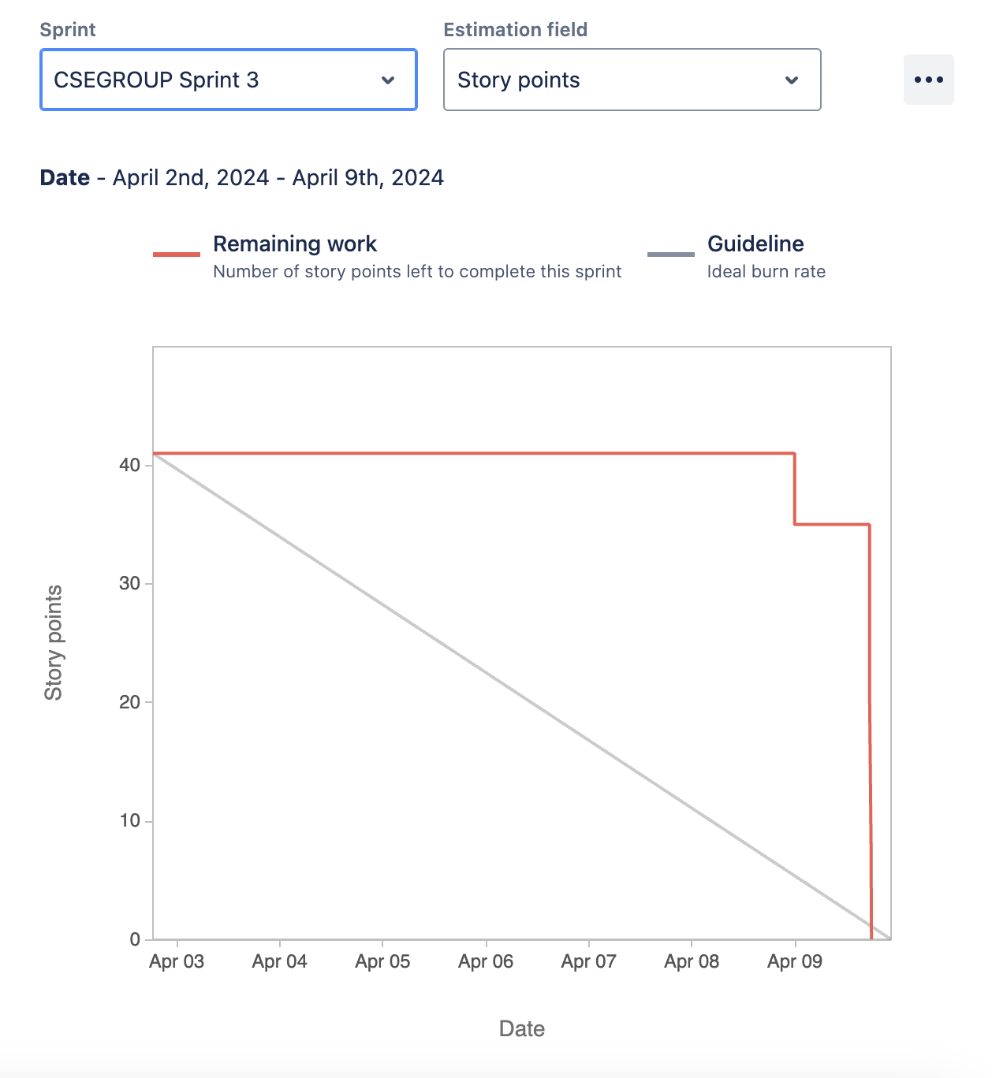
Sprint 3

Slide 7
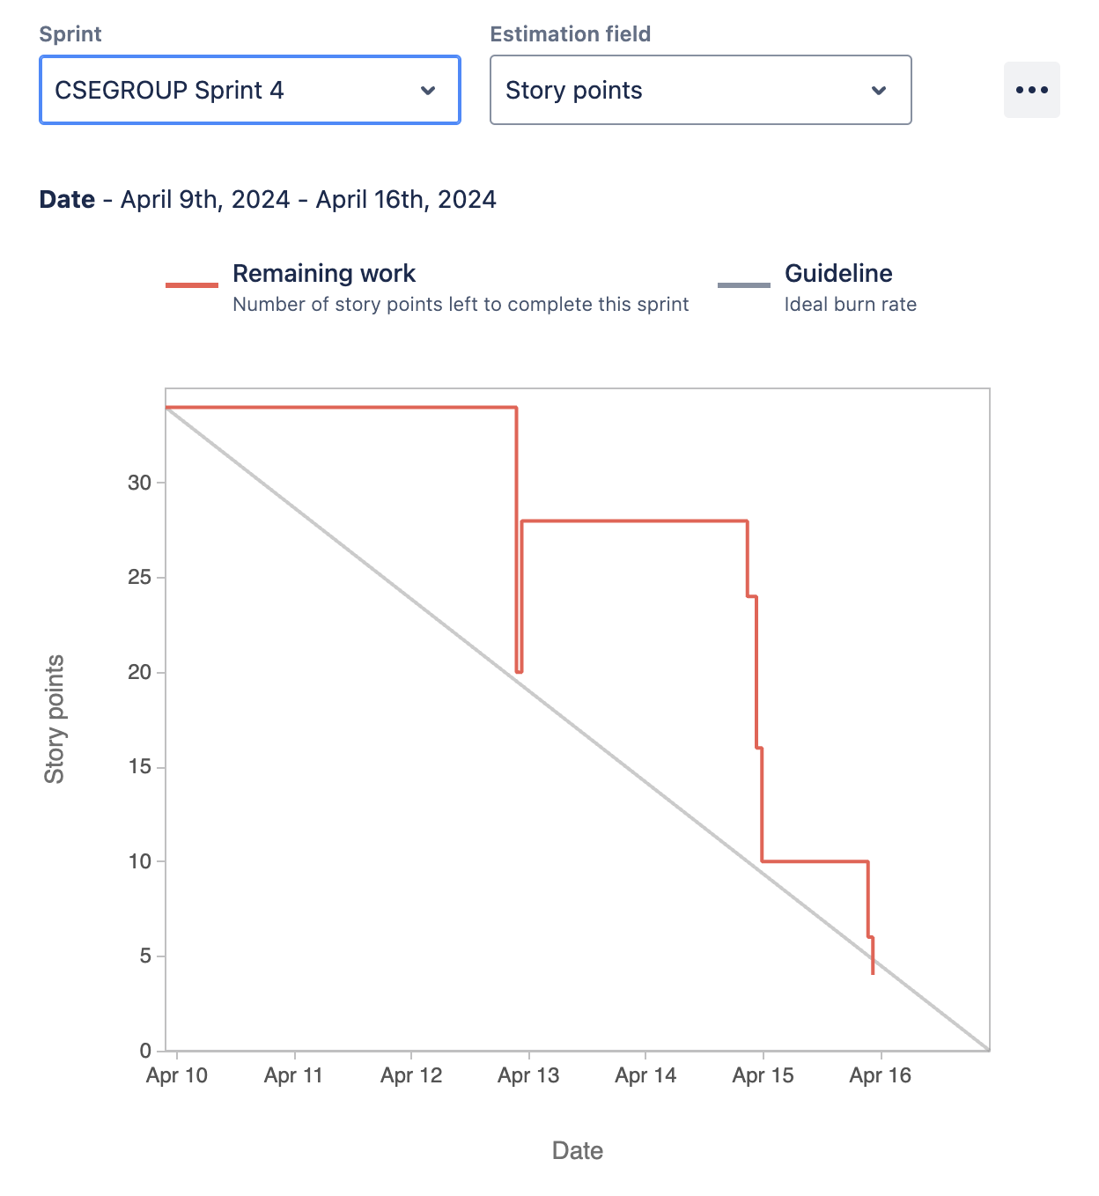
Sprint 4

Slide 8
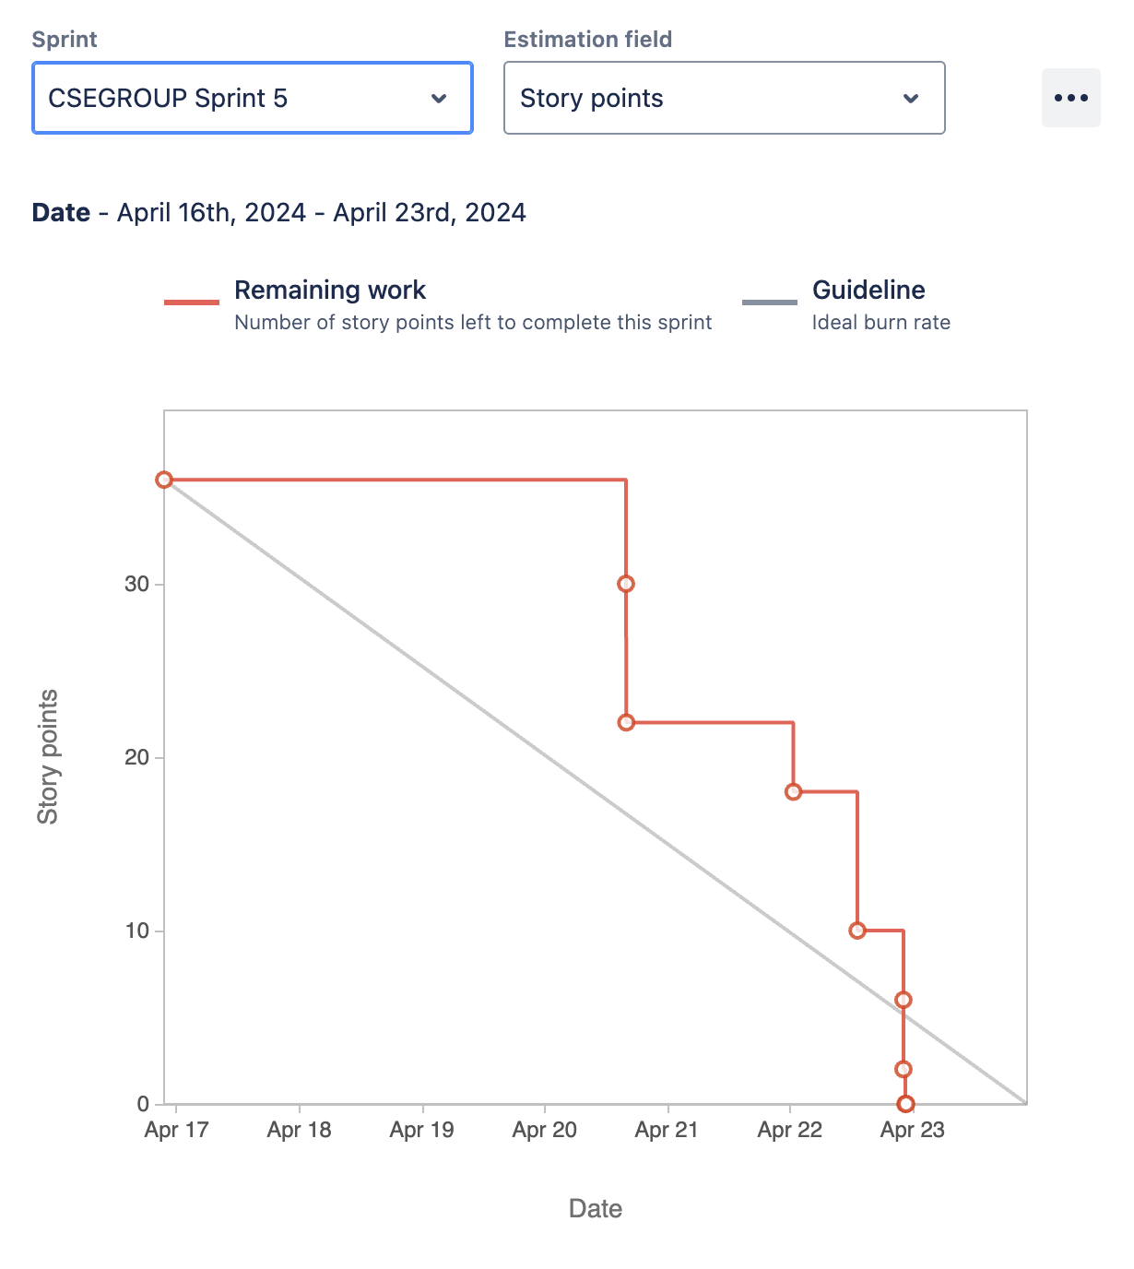
Sprint 5

